Slide 1

Quantum Communications Group
Weekly Report
Supervisors:
Armando Nolasco Pinto
anp@ua.pt
Diogo Matos
dftm@ua.pt

Slide 2
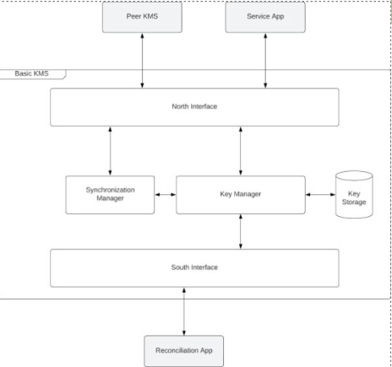
Pull & Push Modes
The exchange of messages on the north interface in pull mode is working well
We are having some problems with the south interface in push mode:
The TCP packets are randomly encapsulating many responses in one.

